Slide 1
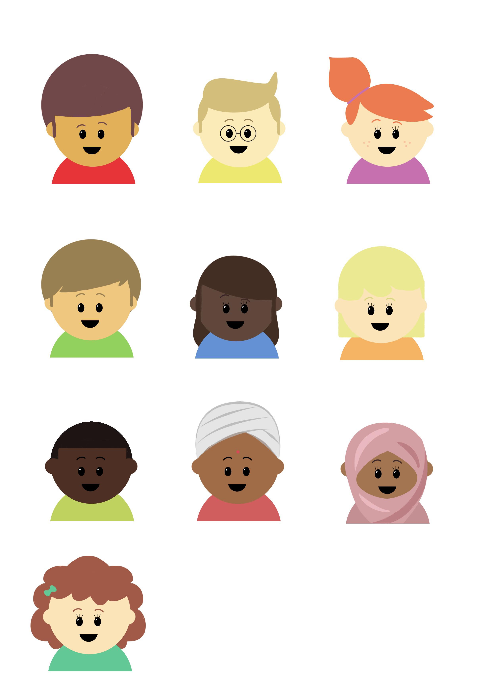

Progression in Mastery
Year 5 Fractions as Operators
Time to explore fractions as operators!
©Deepening Understanding LTD 2020

Slide 2




Let’s do this!
There were 20 doughnuts in a box.
Ranjit ate two tenths of them.
How many doughnuts are left?
©Deepening Understanding LTD 2020

Slide 3
Let’s revisit what we should know…
To find the fraction of an amount, we can use bar models to help us.
56 has been shared into _____ equal groups.
Each equal part represents one _________.
56
©Deepening Understanding LTD 2020

Slide 4
Let’s revisit what we should know…
To find the fraction of an amount, we can use bar models to help us.
1 | of | 56 | = 56 ÷ 7 = ?
7
56
©Deepening Understanding LTD 2020

Slide 5
Let’s revisit what we should know…
To find the fraction of an amount, we can use bar models to help us.
3 | of | 56 | = 8 x 3 = ?
7
56
8 | 8 | 8 | 8 | 8 | 8 | 8
©Deepening Understanding LTD 2020

Slide 6
Let’s learn
Finding the fraction of an amount is the same
as multiplying the fraction by the amount.
4 has been shared into _____ equal groups.
Each equal part represents one _________.
4
We all say it!
You say it!
I say it!
©Deepening Understanding LTD 2020

Slide 7
Let’s learn
6 | of | 4 | = 0.5 x 6 = ?
8
4
0.5 | 0.5 | 0.5 | 0.5 | 0.5 | 0.5 | 0.5 | 0.5
©Deepening Understanding LTD 2020

Slide 8
Let’s learn
Let’s do that again with multiplication…
When multiplying a non-unit fraction by an integer, the ________
stays the same. You multiply the ________ by the ________.
6
8
6 x 4
8
24
8
x 4 = = = 3
We all say it!
You say it!
I say it!
©Deepening Understanding LTD 2020

Slide 9
Let’s talk
Solve the calculations…
What is the same and what is different?
3 | of | 2 | = ?
4
3 | x | 2 | = ?
4
2
©Deepening Understanding LTD 2020

Slide 10
Let’s talk
Match the equivalent calculations.
Three multiplied by two thirds
15 x
4
5
3 | of | 20
5
5 | of | 12
6
Twenty lots of three fifths
Twelve times five sixths
2 | of | 3
3
4 | of | 15
5
©Deepening Understanding LTD 2020

Slide 11
Let’s develop our learning
Ranjit is calculating two thirds of twelve.
He thinks that using bar models is the easiest method…
Do you agree with him? Explain your reasoning!
©Deepening Understanding LTD 2020

Slide 12
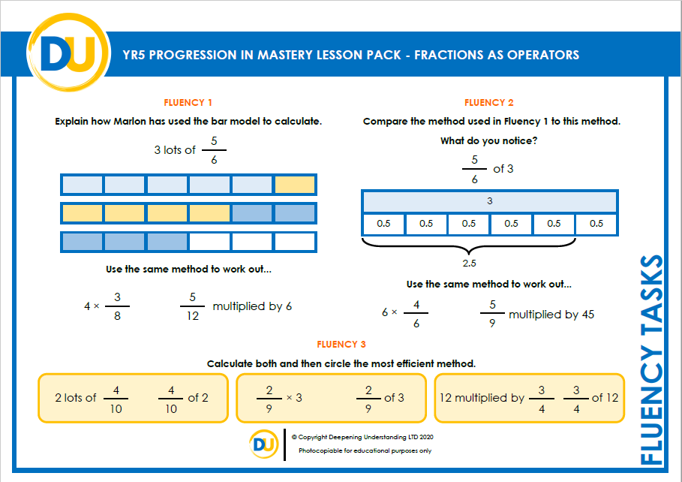
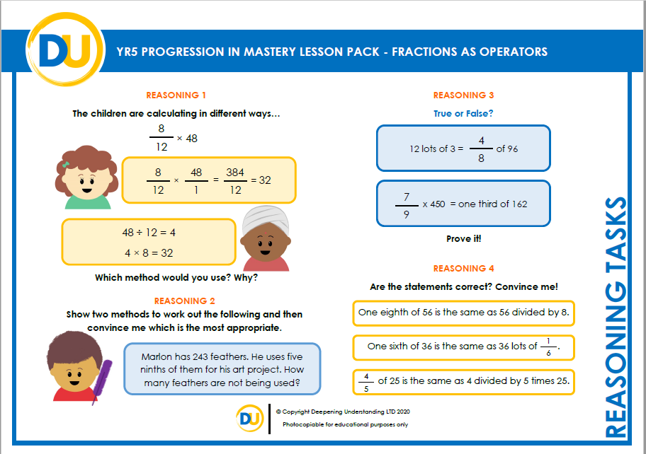
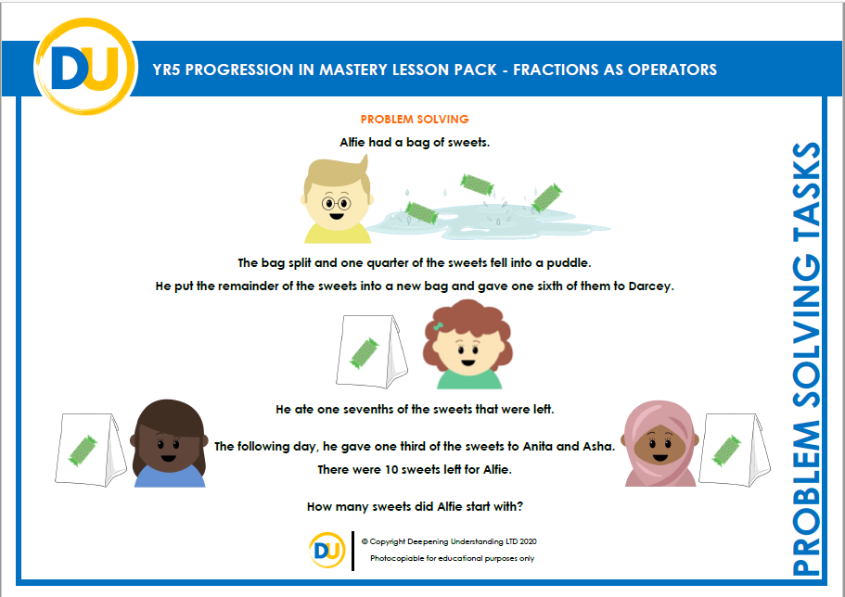
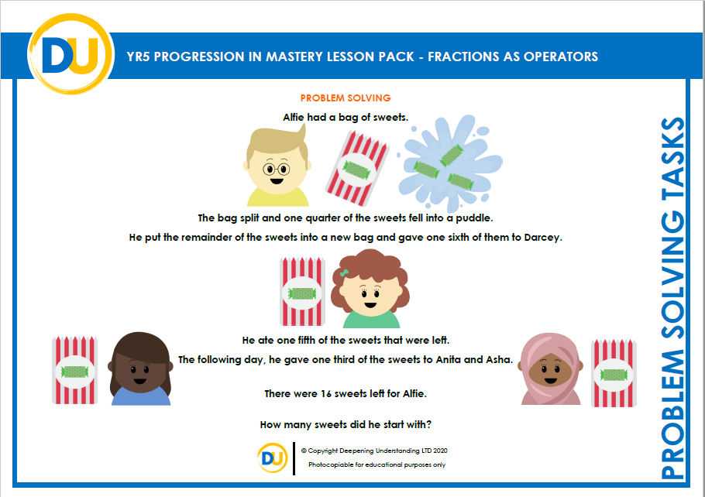
Independent Task
Let’s showcase our learning
©Deepening Understanding LTD 2019

Slide 13
Exit task – Dong Nao Jin
How many different ways can you complete the statement?
of 36 = x 36 =
©Deepening Understanding LTD 2019

